Slide 1
Graduation project Data Analyst Specialist
General Group Code: ONL3_DAT1_G2
Team name: Data Hunters
Project Name: AgriVision

Slide 2
Names of team members
Ahmed Mahmoud Ahmed Ahmed
Asmaa Saeed Abdelaal Qasem
Hossam Gaafer El bahariya
Mohamed Ahmed Abdel Hamid Mohamed
Mohamed Hassan Mohamed Eissa
Yomna Mohamed Mahrous Shalaby (Team leader)

Slide 3

AgriVision is an agricultural company in the United States of America that operates in several sectors of the agricultural field, such as plant, animal, and poultry production.

Slide 4
Company Information:
The company has 5 category with a total of 28 products.
The company distributes its products to 20 customers (retail outlets) in a total of 5 states.
Data analysis and key insights gained during 2022 and 2023 will be presented.

Slide 5
Company
Fruits
Vegetables
Grains
Livestock
Dairy
Apples
bananas
Blueberries
Grapes
Oranges
Peaches
strawberries
Cabbage
Carrots
Lettuce
Onions
Peppers
Potatoes
Tomatoes
Barley
Corn
oats
Rice
Rye
Wheat
Beef
Chicken
Lamb
Veal
Butter
Cheese
Milk
Yogurt

Slide 6
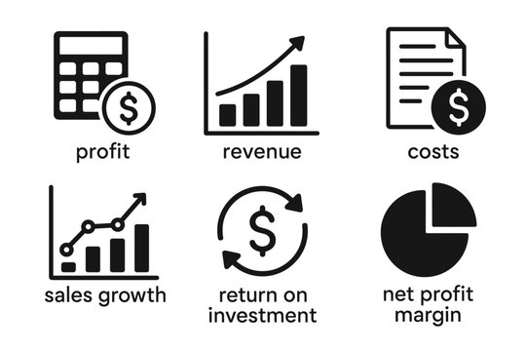
Executive Summary
The most important results obtained from the company's data during the two years 2022 and 2023
Total Sales
6.5 billion
Total Cost
2.3 billion
Total Profit
4.2 billion

Slide 7
Report

Slide 8
Project implementation steps
Data collection
Data cleaning and preparation / transformation
Analysis
Visualization
Reporting

Slide 9
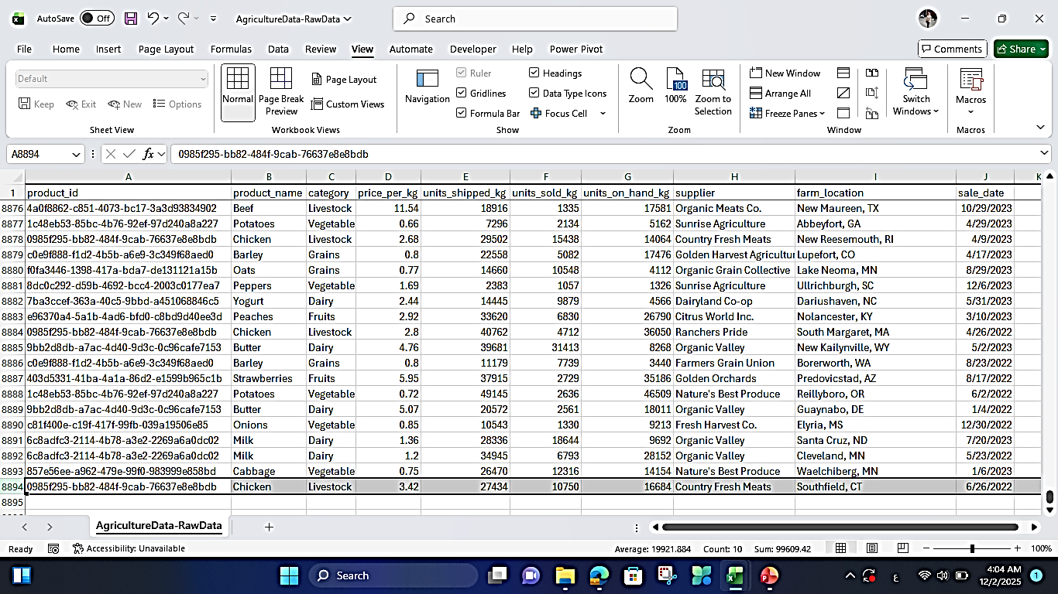
Raw data
The data was obtained from Kaggle website.
Link:
10 columns
8894 rows

Slide 10
Tools and software used
Excel
For data cleaning and preparation
SQL Server Management Studio
For data transformation and analysis
Power BI
For Visualization
Microsoft Word
For writing the report

Slide 11
Steps for data cleaning and preparation by using Microsoft Excel
(Power Query)

Slide 12
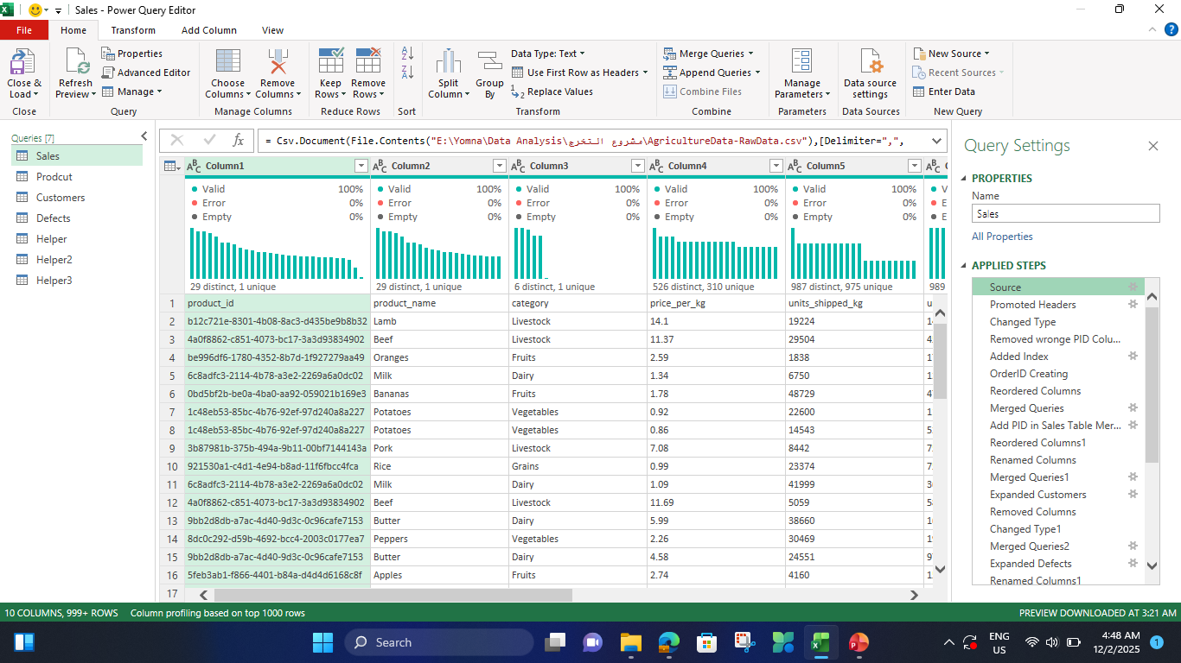
Power Query

Slide 13
Promoted Headers
= Table.PromoteHeaders(Source, [PromoteAllScalars=true])
Changed Type
= Table.TransformColumnTypes(#"Promoted Headers",{{"product_id", type text}, {"product_name", type text}, {"category", type text}, {"price_per_kg", type number}, {"units_shipped_kg", Int64.Type}, {"units_sold_kg", Int64.Type}, {"units_on_hand_kg", Int64.Type}, {"supplier", type text}, {"farm_location", type text}, {"sale_date", type date}})

Slide 14
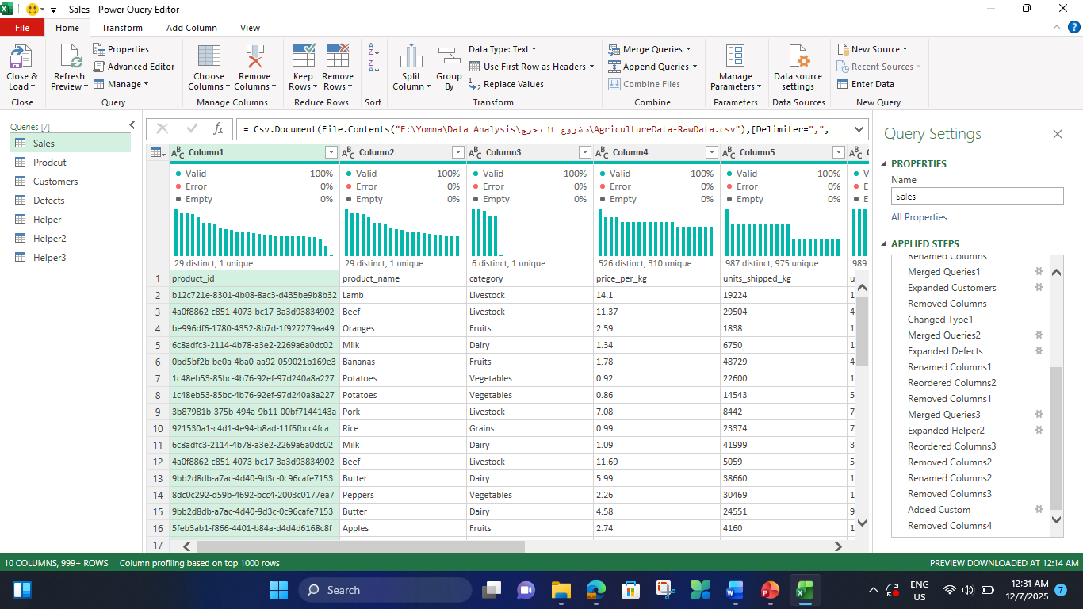
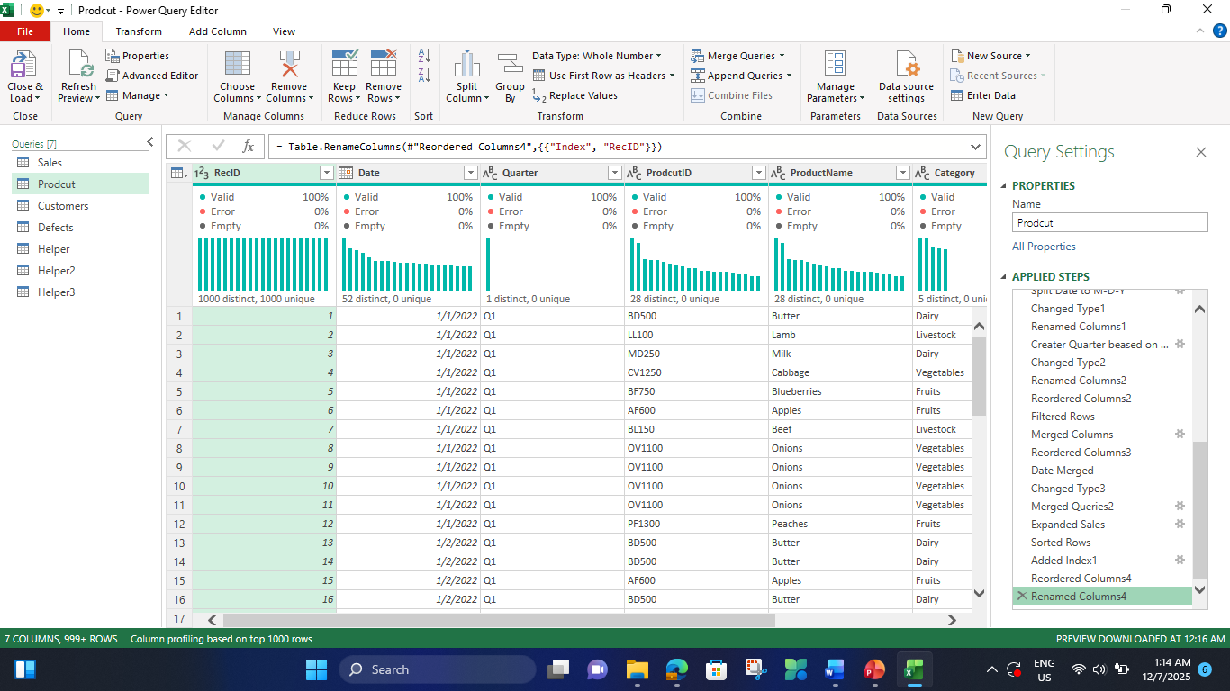
Insert 3 new columns : RecID – Date – Quarter
We took 3 columns from the raw data without modification : ProductID – ProductName – Category
The column containing the data for Price_Per_Kg was used and renamed the column to “Sales_Price_Per_Kg ".
Products table

Slide 15
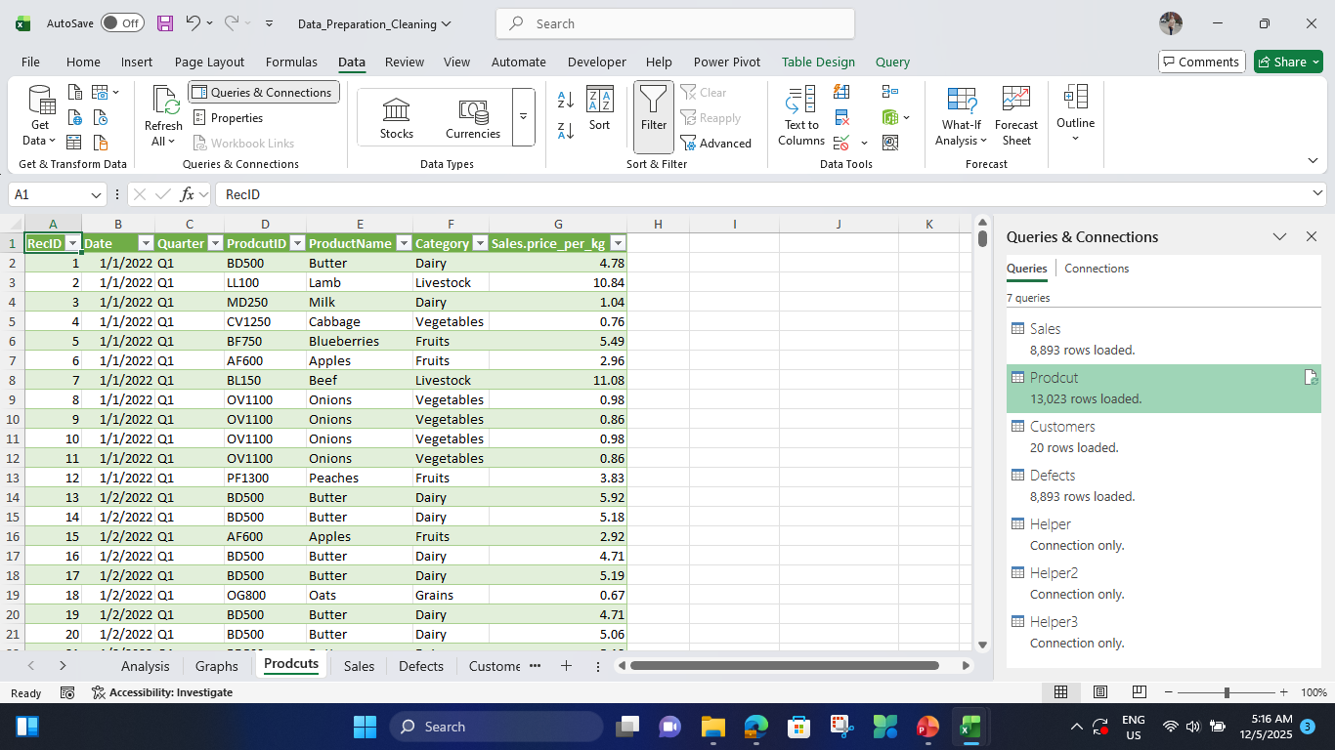
Products table

Slide 16
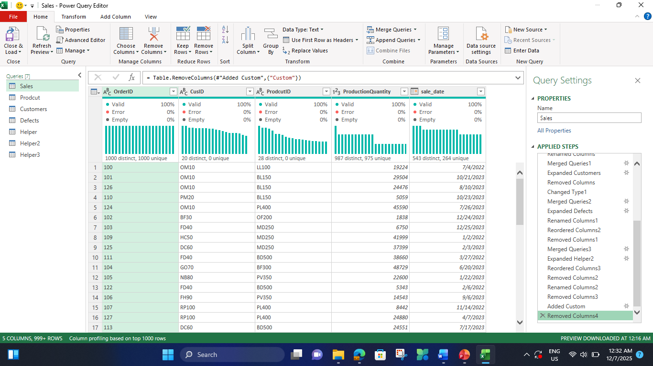
Sales table
Insert 2 new columns : OrderID – CusID
We took 2 columns from the raw data without modification : ProductID – Sale_date
The column containing the data forUnits_Shipped_Kg was used and renamed the column to “ProductionQuantity".

Slide 17
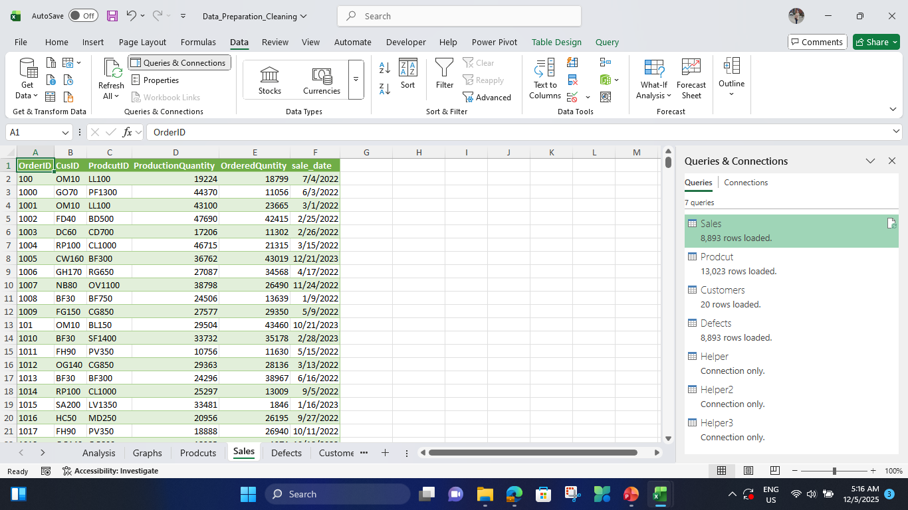
Sales table

Slide 18
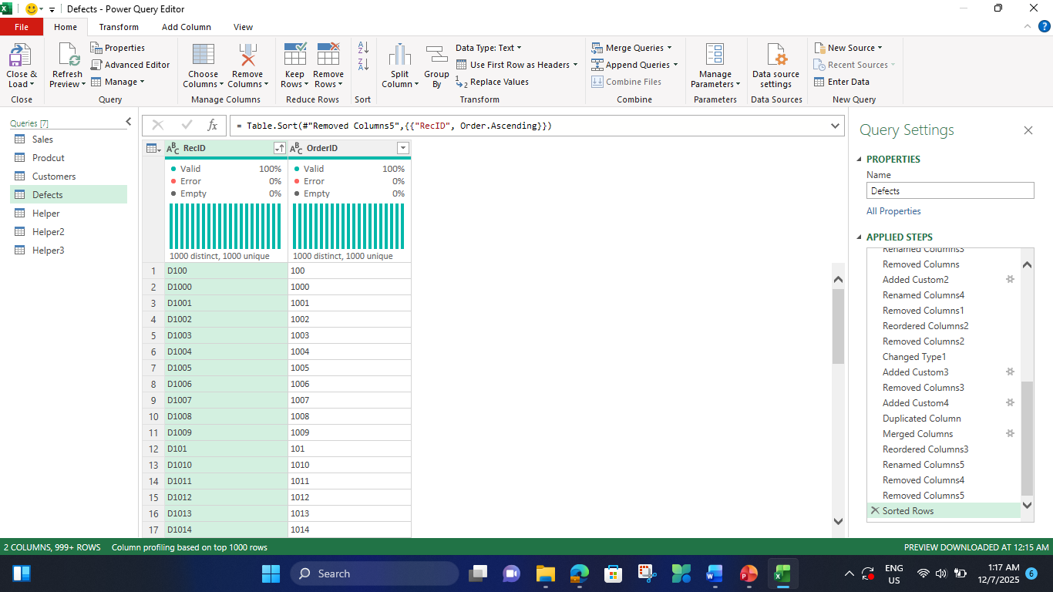
Defects table
Insert 2 columns : RecID - OrderID “

Slide 19
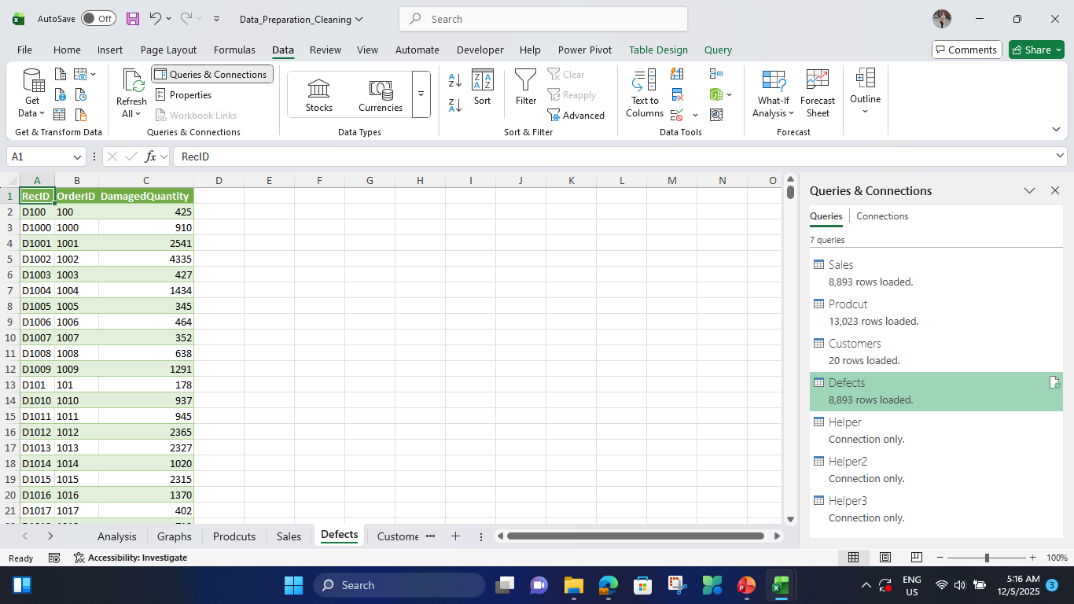
Defects table

Slide 20
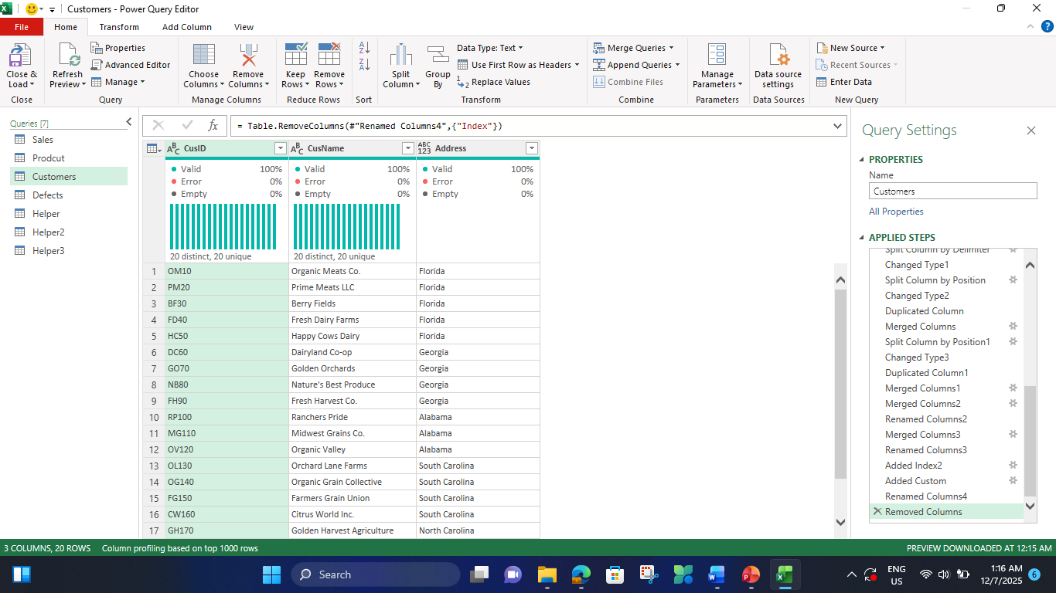
Customers table
Insert 2 new columns : CusName – Address and CusID column

Slide 21
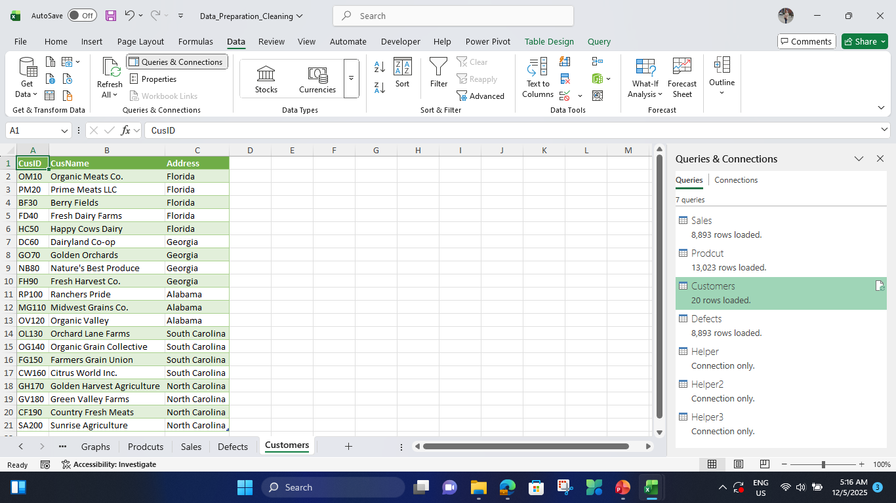
Customers table

Slide 22
SQL
A
Sales Table to FactSales View
B
Products Table to PRODCUTS View
C
Defects Table to DEFECTSQ View
D
Customer Table to Customer Table

Slide 23
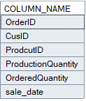
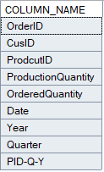
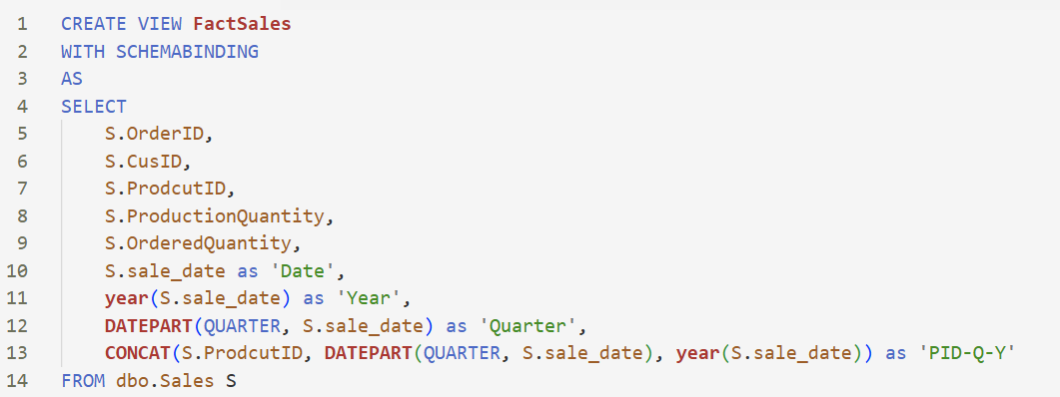
Sales Table to FactSales View

Slide 24
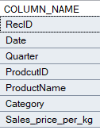
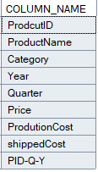
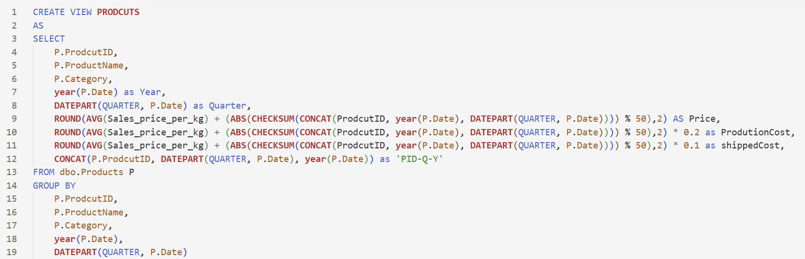
Products Table to PRODCUTS View

Slide 25
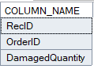
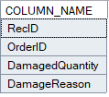
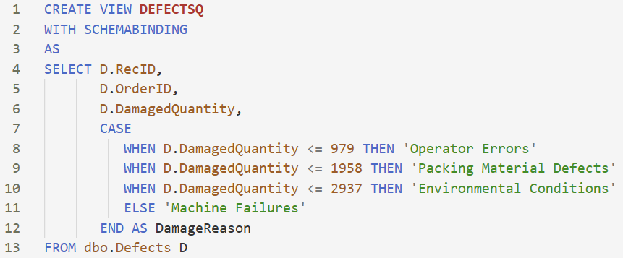
Defects Table to DEFECTSQ View

Slide 26
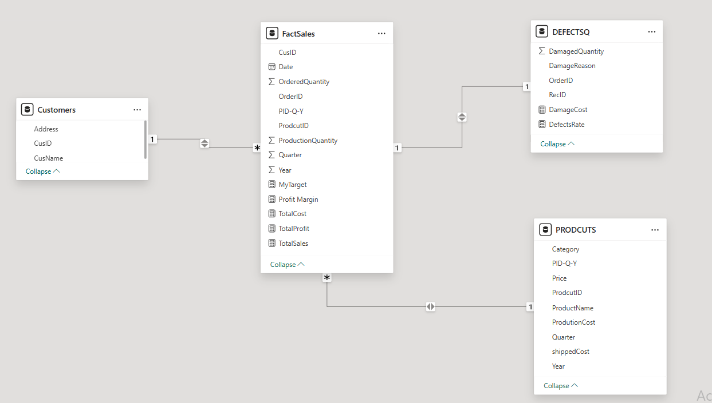
Power BI
Data Modeling

Slide 27

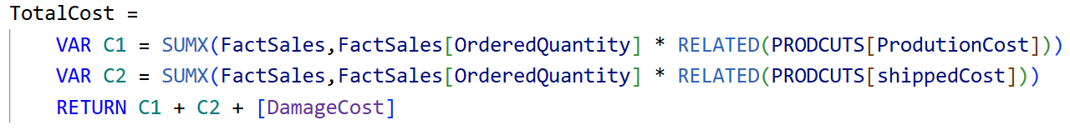
Power BI
Measures

Slide 28
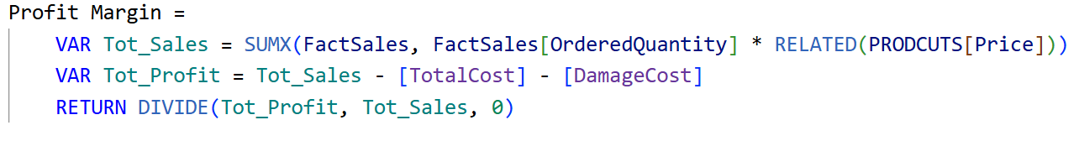
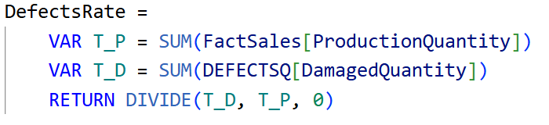
Power BI
Measures

Slide 29
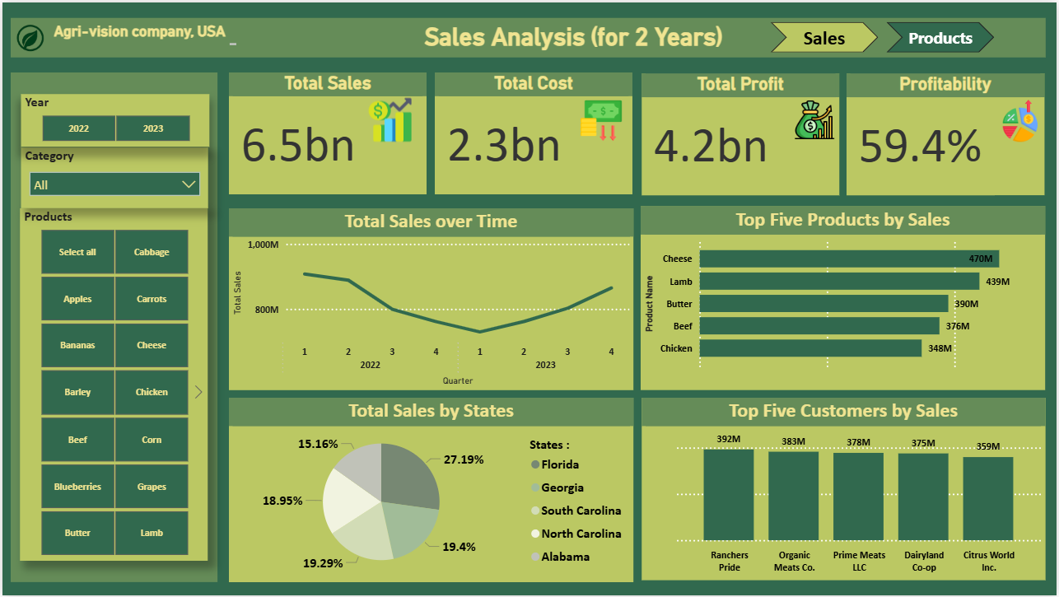
Power BI Dashboard

Slide 30
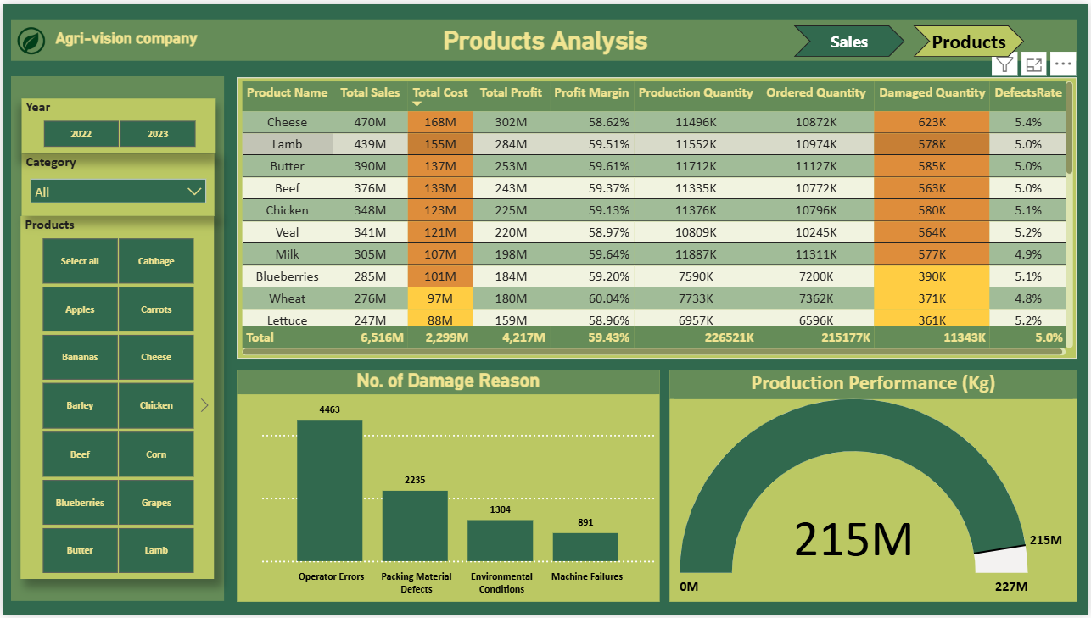
Power BI Dashboard

Slide 31
Thank you

